Slide 1
Restaurant Revenue Prediction
CSCE 421-200 Machine Learning
David Roh

Slide 2

Introduction
Importance of accurate revenue prediction in the restaurant industry
Complexity of predicting restaurant revenue
Motivation: data-driven approach for revenue prediction
Factors that make Restaurant Revenue Prediction difficult:
Economic conditions
Competition
Consumer behavior
External events

Slide 3
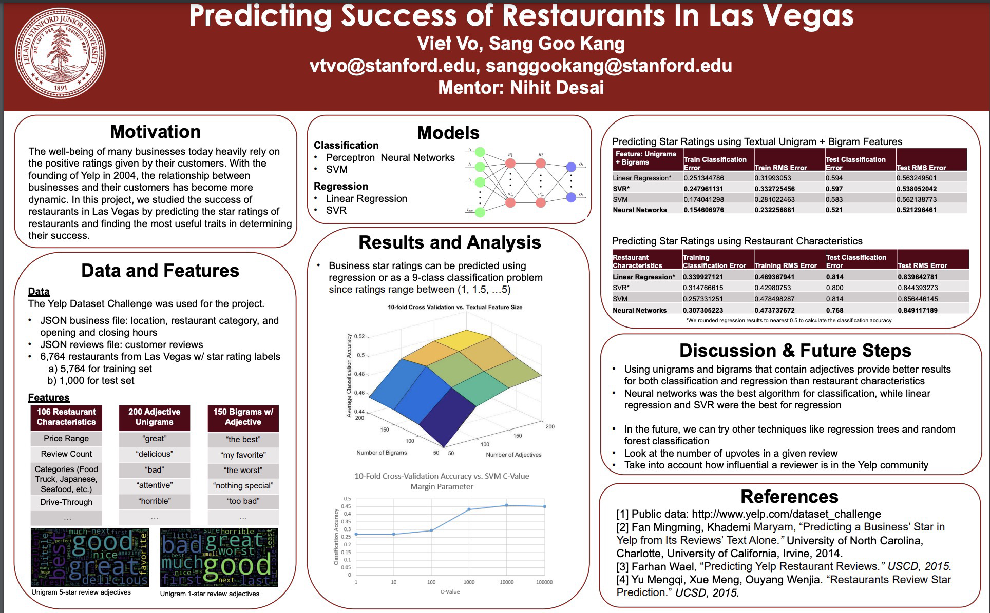

Literature Review
Kaggle competition (2015) and Taruto (2020) insights
Stanford study on predicting restaurant success using Yelp data (Kang & Vo, 2016)
Gap in the literature

Slide 4
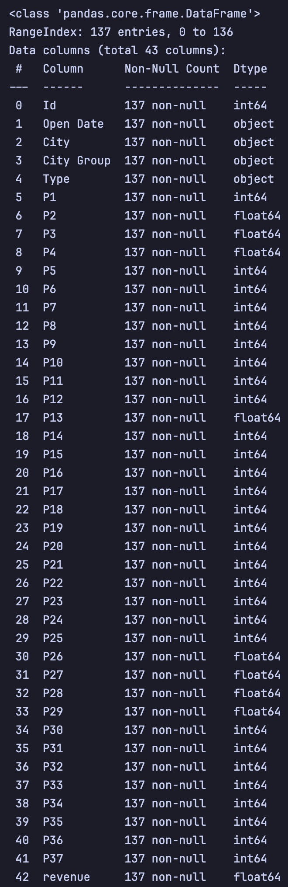
Problem Introduction
Training set of 137 Restaurants
Test set of 100000 Restaurants
Data included:
Opening Date
City
City Type (Large or not)
Restaurant Type (Food Court, InLine, Drive Through, Mobile
37 Obfuscated Features (demographic, real estate, and commercial)
Target: Revenue

Slide 5
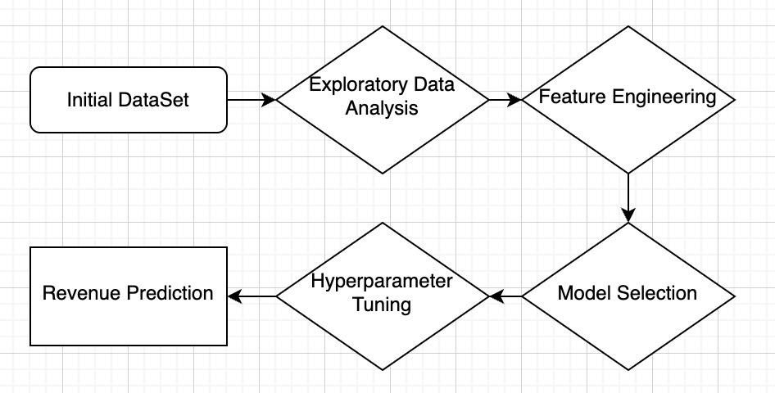
Proposed Solution

Slide 6
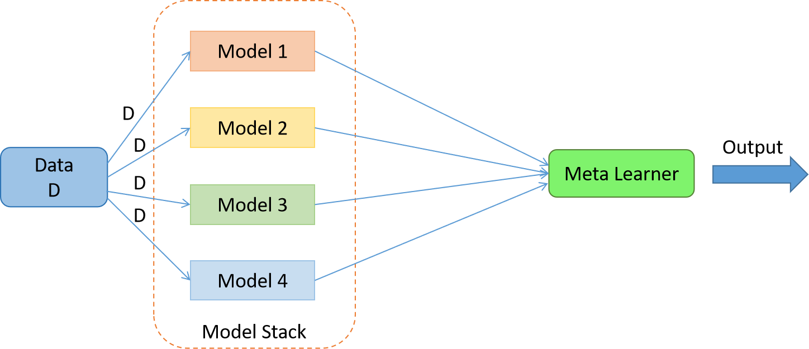
Model Selection & Hyperparameter Tuning
Models: Catboost, Random Forest, ElasticNet, Gradient Boosting, KNN, Lasso, LightGBM, Linear Regression, Ridge, SVR, Sequential Neural Network, and XGBoost
Ensemble stacking technique

Slide 7
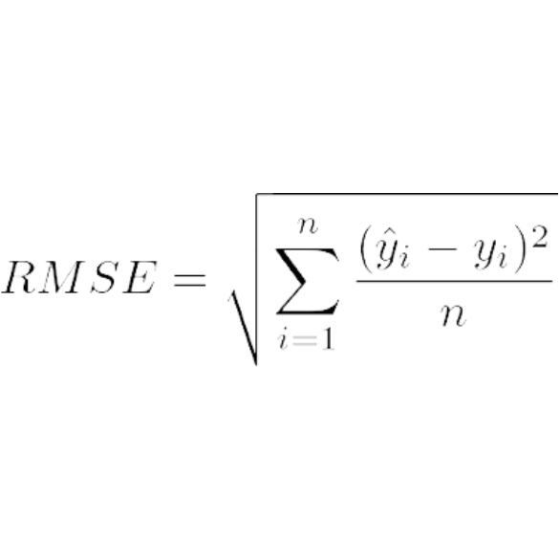
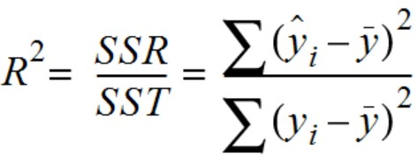
Evaluation Metrics
RMSE and R^2 metrics for model performance evaluation

Slide 8
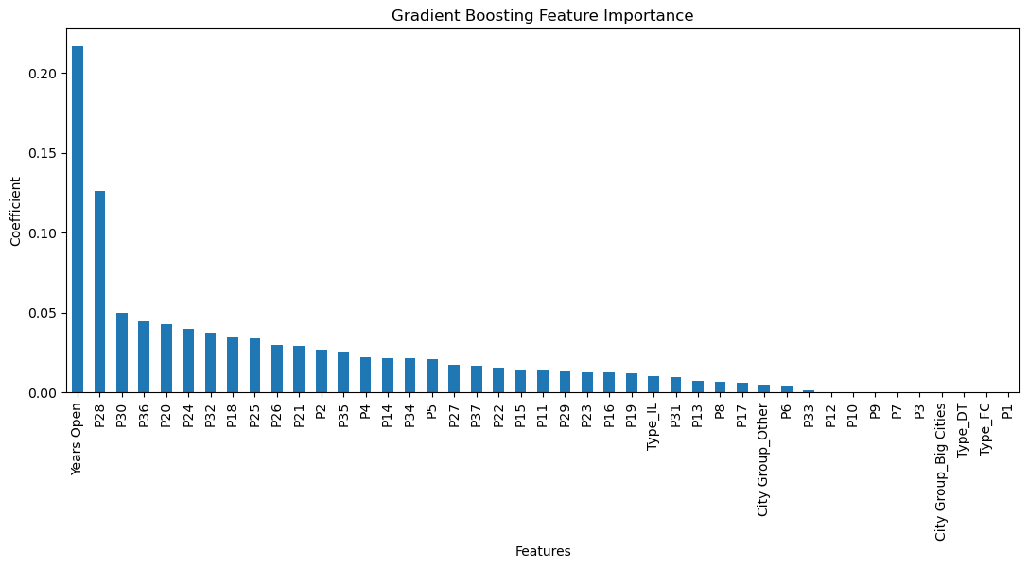
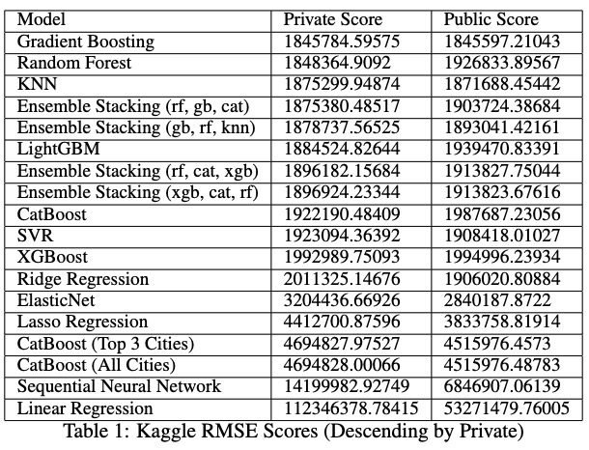
Results
Best performing model: Gradient Boosting
Reasonable performance: Random Forest, KNN, and LightGBM
Ensemble stacking not significantly improving performance
Potential overfitting issue

Slide 9
Limitations and Future Directions
Limitations:
Limited feature engineering: Despite some success, more advanced techniques could be explored.
Overfitting: Some models might perform well on the training data but not generalize well to unseen data.
Small dataset: The available data for training and validation is relatively small, potentially limiting model performance.
Obfuscated features: The dataset includes obfuscated features, making it difficult to understand their impact on revenue prediction.
Potential Improvements:
Feature engineering: Investigate additional feature engineering techniques to improve model performance.
Diverse models: Explore a wider range of machine learning models to capture different relationships in the data.
Regularization: Implement unique regularization techniques to reduce overfitting and improve generalization.
Ensemble stacking: Experiment with different stacking techniques and algorithms to improve ensemble learning performance.

Slide 10
Conclusion
Developed a machine learning model for predicting restaurant revenue
Gradient Boosting as the best-performing model
Room for improvement in feature engineering, model diversity, and addressing overfitting

